Slide 1
ENSE 374, Milestone 2
Team Explore The World
Mohamed Bashir, Karlee Fidek, Rishabh Prasad
October 23, 2019

Slide 2
MVC Architecture
Project Blurb
We would like to create an application that recommends our users meaningful travel locations based on their interests and preferences, but also inspires them to experience various cultures and parts of the world.

Slide 3
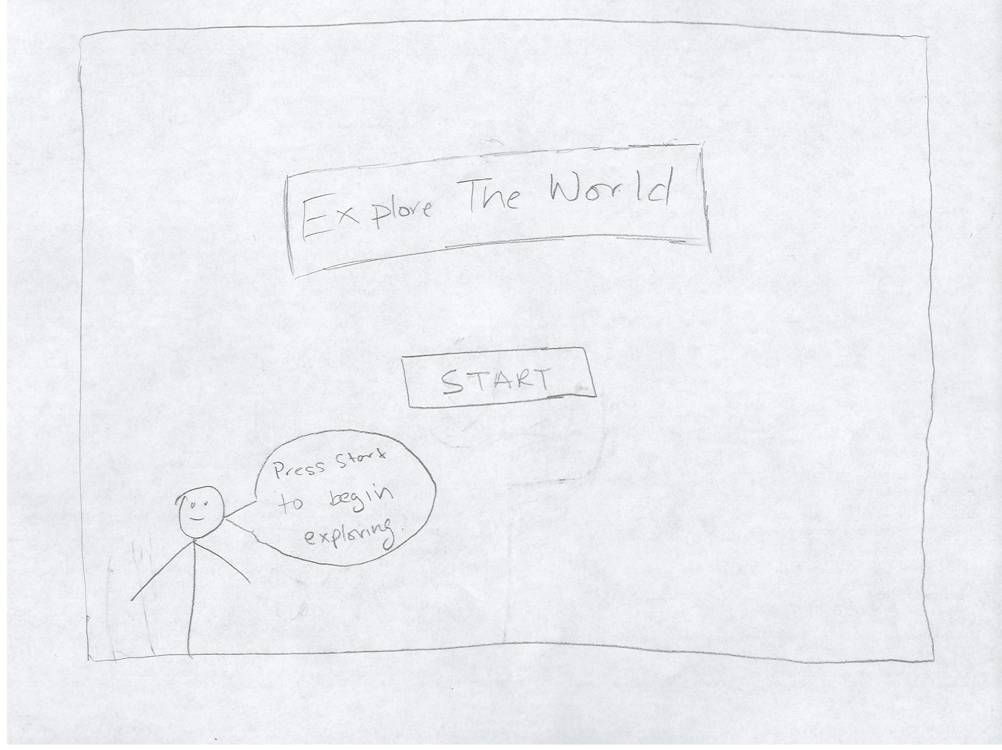
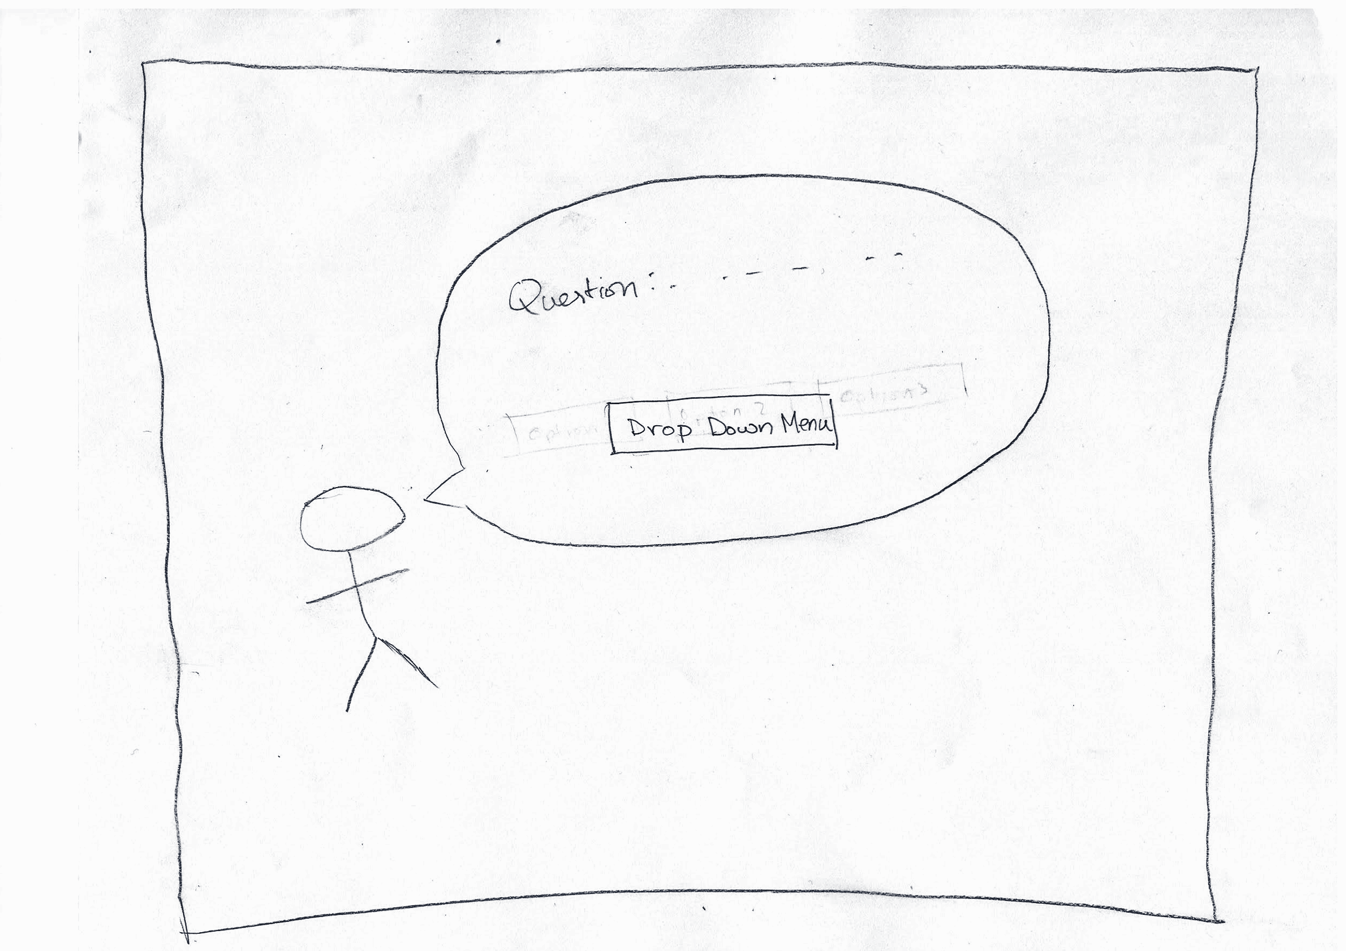
Lo-Fi Prototypes
Initial start Page
2) Questions

Slide 4
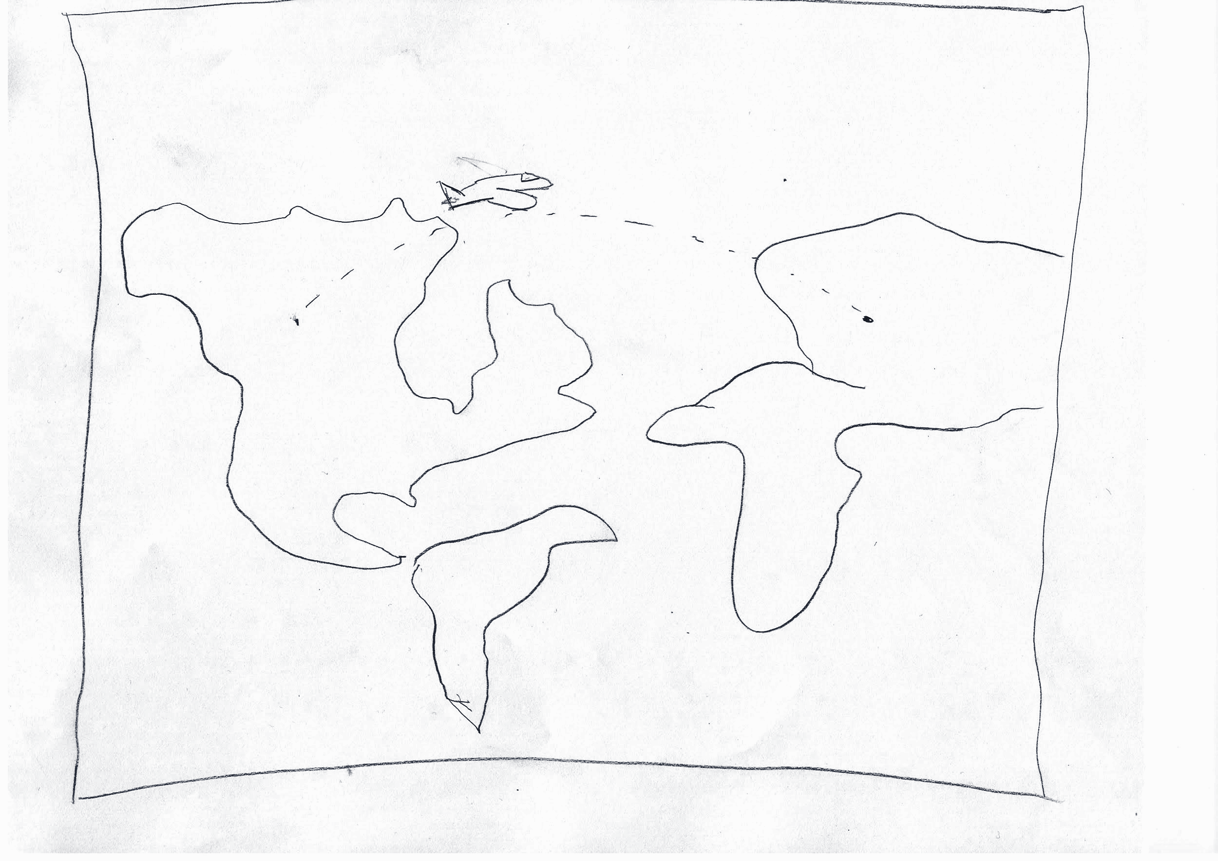
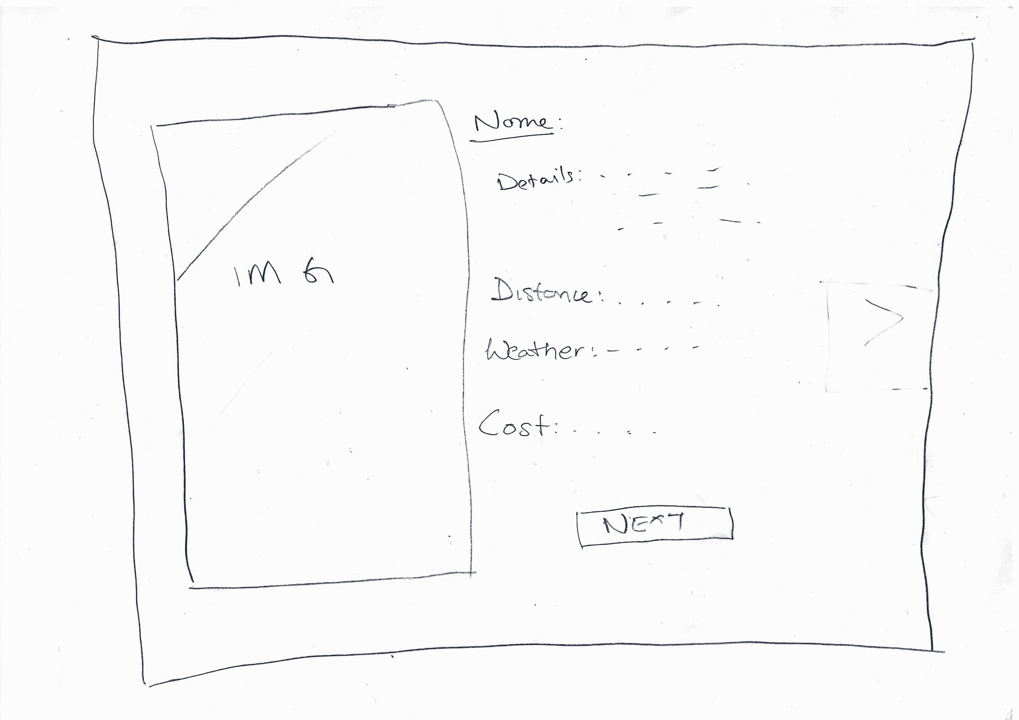
Lo-Fi Prototypes Cont.
3) Loading Screen / Animation
4) Location Information

Slide 5
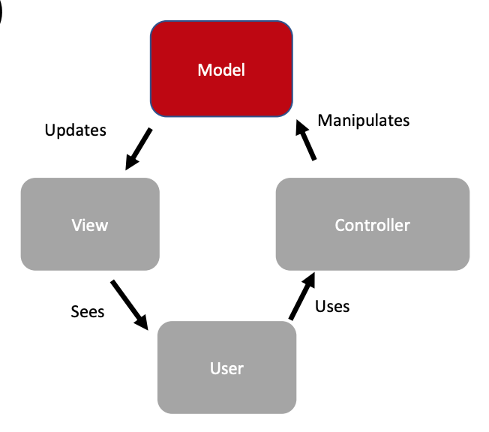
MVC Architecture
-
Model
Travel locations and attractions
Hobbies
Seasons
Budgets

Slide 6
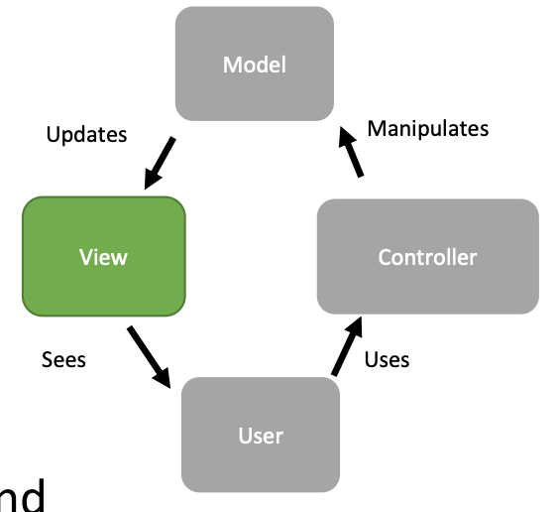
MVC Architecture
-
View
Simple, clean design
Minimal extra elements
Easy to use

Slide 7
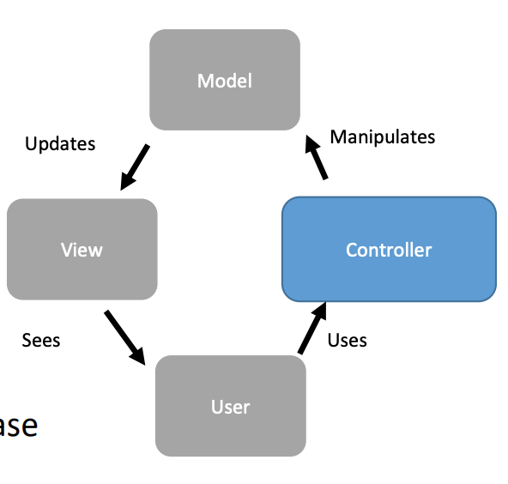
MVC Architecture
-
Controller
Preference input
Map of travel recommendation

Slide 8
Domain Driven Design
Interface, Sequence Diagram, MVP
Start simple, and add more as we go
Complete and functioning application is more beneficial for user than complex and error-prone
Activity state diagram
User interaction and input will be used to compare with data

Slide 9
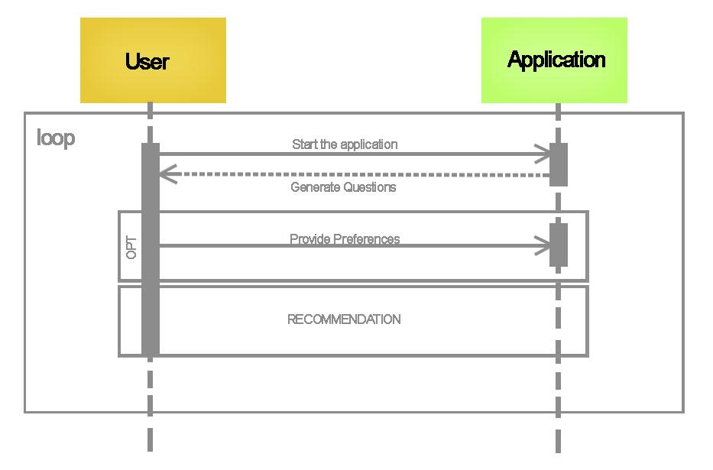
Sequence Diagram
The user starts the application
The user enters question details - for example , choose a season to travel , interest/hobbies , etc
A recommendation location is shown to the user

Slide 10
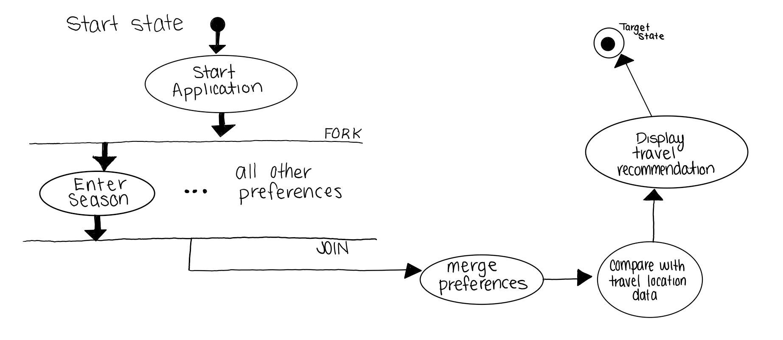
Activity State Diagram
The user starts the Application
The user enters question details for example , choose a season to travel , interest/hobbies , etc
A recommendation location is shown to the user

Slide 11
Requirements, Kanban & GitHub review
Requirements document
Updated Kanban
Addition/change/movement of user stories
MVP-1
Keep it simple and get one or two preference inputs linking to locations
Envisioned Barrier: Finding the best way to link preferences to locations
GitHub
Files structure

Slide 12
Group reflection
How did you feel about this milestone?
It helped build a structure for the application, discover issues in our plan, as well as created a better understanding of how the application will perform
What did you learn about yourself as you collaborated and worked through this milestone?
We work well together. As one person falls behind, the others help to make adjustments so they job can be accomplished timely.
How will you use what you have learned going forward?
As we grasp the positive qualities of each team member, we must assign roles and responsibilities which each member can excel at for future tasks.

